Slide 1



Using Search to break down information silos
Kasper Larsen
Senior Solution Architect,
MVP (M365, SharePoint & Graph)
kasperbolarsen
kasperbolarsen

Slide 2





























Slide 3


Slide 4

So why are you here?

Slide 5
General intro to Graph Connectors
PnP Modern Search – when to use and when NOT to use
Non-technical factors when selecting the solution design
Setting up the solution
And finally, a surprise

Slide 6
Definitions – Graph Connectors

Slide 7
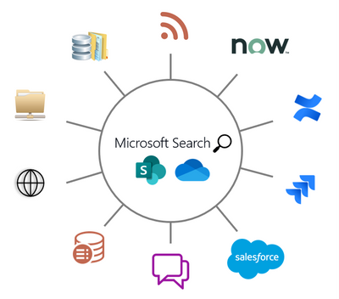
How do we bring 3rd party data into M365?
Graph Connectors – some background
Nothing new –
Business Connectivity Services (retired 2023+)
Business Data Connectivity
Business Data Catalog

Slide 8
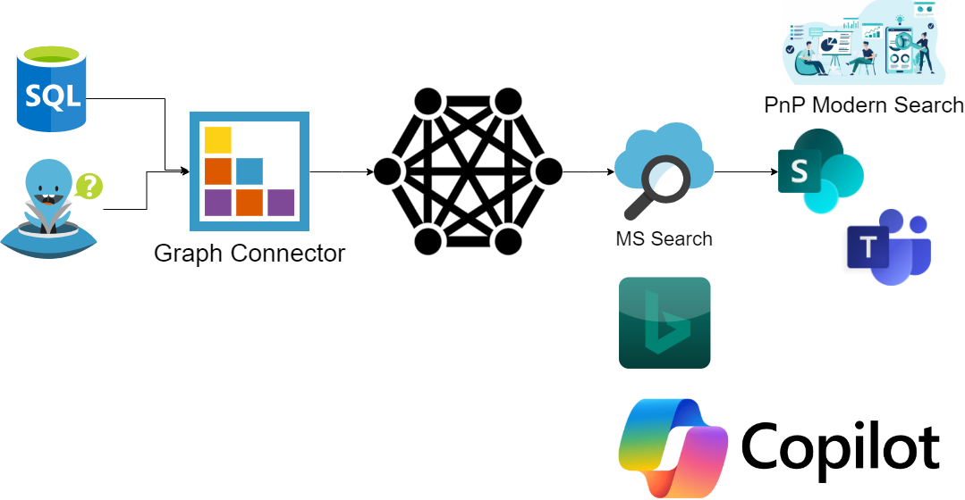
How do we bring 3rd party data into M365?
.

Slide 9
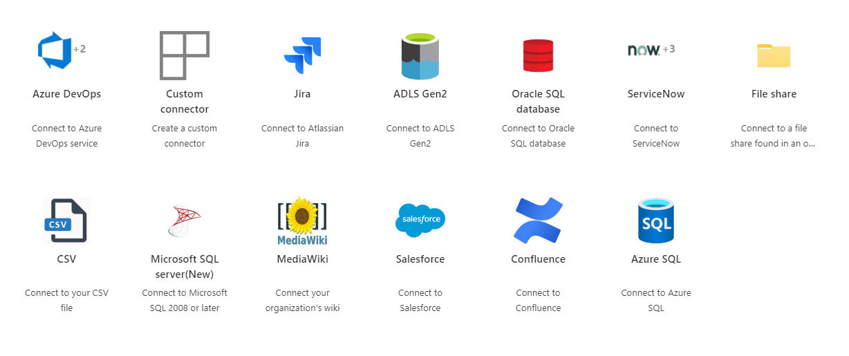
How do we bring 3rd party data into M365?
.

Slide 10



How do we bring 3rd party data into M365?
Questions about Custom connectors?
.
Waldek Mastykarz, Garry Trinder and Paolo Pialorsi

Slide 11
Definitions – PnP Modern Search

Slide 12
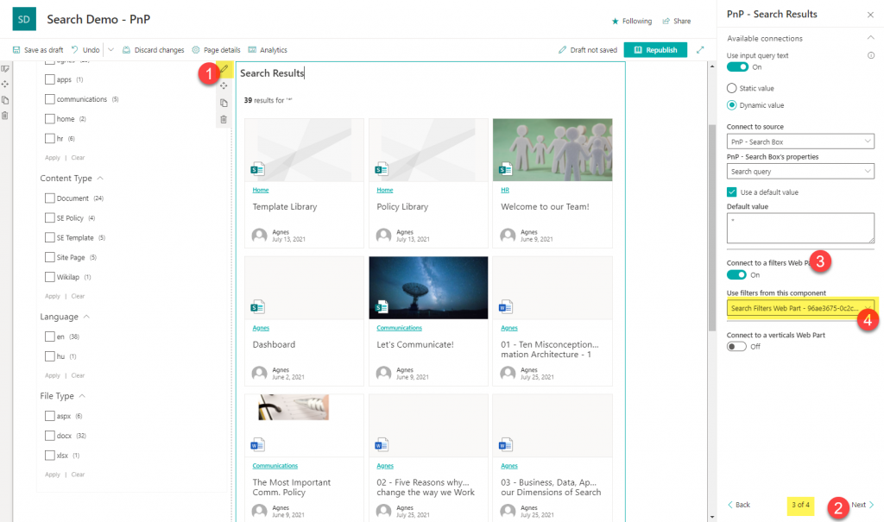
PnP Modern Search
Open Source
Community driven
Delivers what MS didn’t
Used on thousands of tenants
Supports both SharePoint and Microsoft Search as sources

Slide 13
PnP Modern Search – when to use and when not
Custom Search
General Search
Company policies
Case management
Project Management
Contracts
Product catalog
Stick to Out of the Box Microsoft Search
It is the Search experience you will see EVERYWHERE

Slide 14
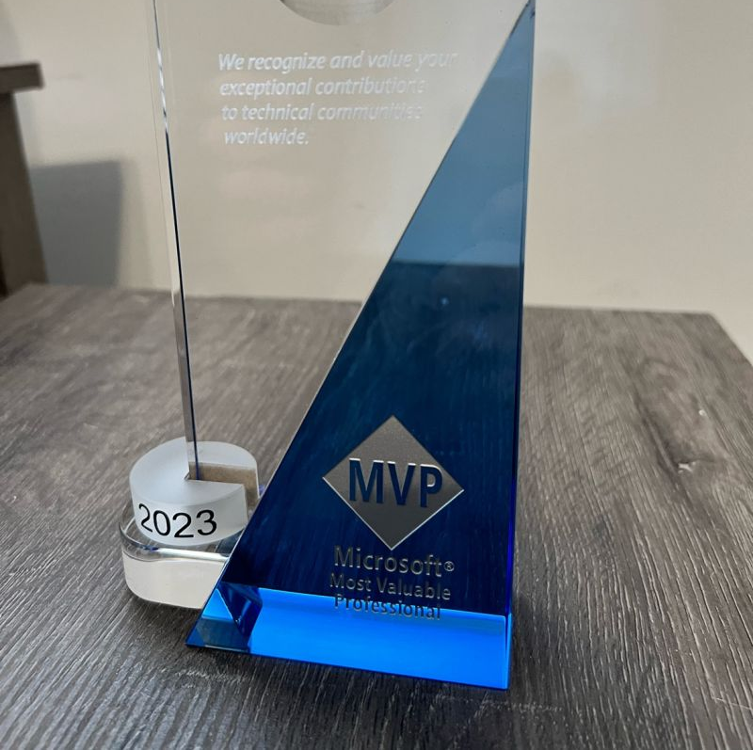
Speaking about PnP
Be careful
Side effect you didn’t anticipated
Began after ESPC Prague 2019
PnP Script Samples
PnP Modern Search
2024: member of PnP Core team

Slide 15
The customer case

Slide 16

Some background
Contoso
Started as a construction Company in 1962

Slide 17

Some background
Founder John Sanders
His lesser known twin brother was a chicken farmer or something

Slide 18

Some background
Branched out as Contoso Building Management

Slide 19

Some background
Expanded into Canada and Mexico
Changed name to
International Contoso Building Management
( ICBM )
Notes:
ICBM - Institut für Chemie und Biologie des Meeres , Universität Oldenburg

Slide 20


The two systems and bringing them together
Assets & Buildings Obligatory Management Baseline
(A.B.O.M.B)
Maintenance & Assets Database (MAD)

Slide 21
Assets & Buildings Obligatory Management Baseline (A.B.O.M.B)

Slide 22
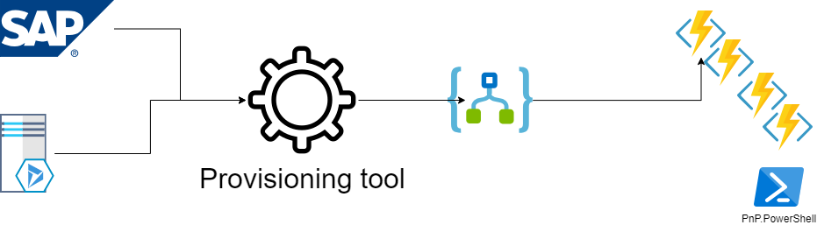
Basic design
.

Slide 23
DEMO TIME

Slide 24
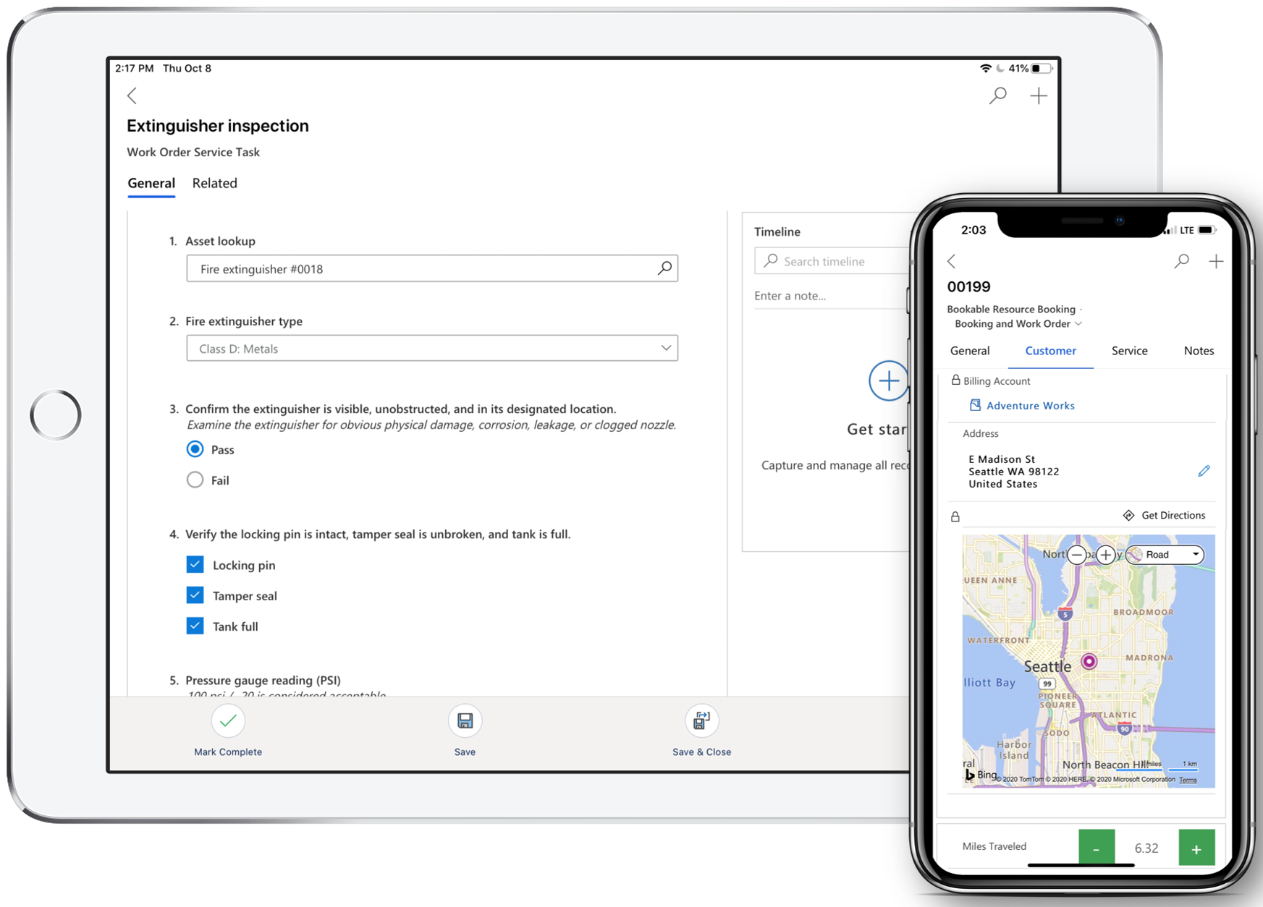
The two systems and bringing them together
Asset & Building Obligatory Management Baseline
(A.B.O.M.B)
Maintenance & Assets Database (MAD)

Slide 25
Factors when selecting the best solution
Where is the data coming from?

Slide 26
Factors when selecting the best solution
Inhouse ? Go for it
The MAD system is ours and we can use any approach

Slide 27
Factors when selecting the best solution
Inhouse –sort of
The MAD system is owned by another department, and we might have to provide and maintain a custom connector or use an out of the box?

Slide 28

Factors when selecting the best solution
Inhouse –sort of
The MAD system is hosted and running in our environment BUT is owned and developed by a 3rd party
Similar to using SharePoint On Premises databases, it *might* change with the next patch !!!

Slide 29

3rd party –
legal issues
3rd Part but having an Enterprise agreement (free seats) Go for it
3rd Part (paying per seat)
Warning, here be monsters

Slide 30
Factors when selecting the best solution
3rd party / SAAS
The MAD system is hosted and running in outside our environment.
3rd Part but having an Enterprise agreement (free seats) Go for it
3rd Part (paying per seat)
Warning, here be monsters

Slide 31
DEMO TIME
The Azure SQL based approach
Why Azure SQL?

Slide 32
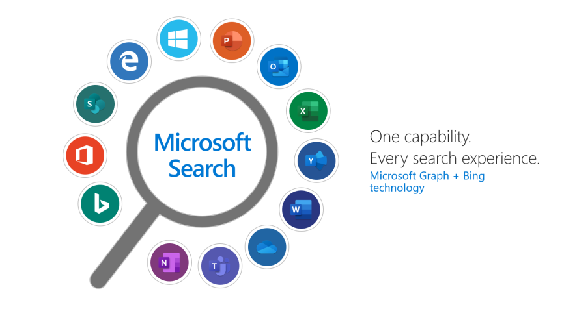
Integrate with Search
Available in Microsoft Search
”All” and custom tab

Slide 33
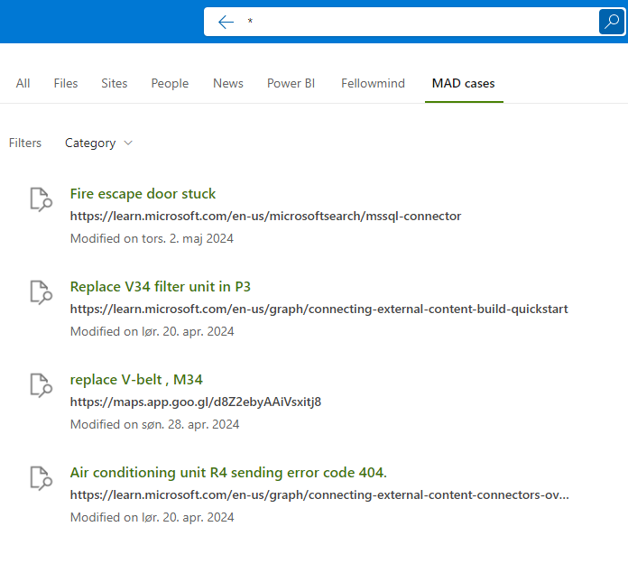

Slide 34

Integrate with PnP Modern Search

Slide 35

So which solution did the customer pick ?

Slide 36

A business case that doesn’t fly

Slide 37

Back to the drawing board, bypassing Graph Connector

Slide 38
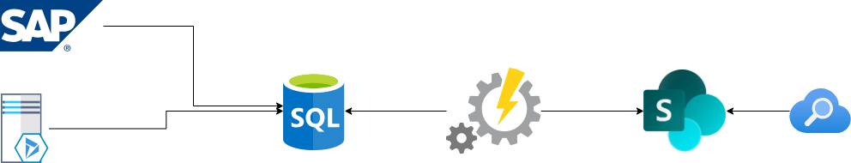

Slide 40
DEMO TIME
Final result

Slide 41

Questions?

Slide 42
THANK YOU, YOU ARE AWESOME ❤️
PLEASE RATE THIS SESSION IN THE MOBILE APP.
Wanna know more, follow me on X (@kasperbolarsen) , LinkedIn or my blog (https://www.m365thinking.com/blog)

